Slide 1
Git and GitHub
A developer’s best Friend
By ,
Akshay Bhandarkar H
8th sem ISE

Slide 2

What is git ?
Git is a Version Control System (VCS) designed to make it easier to have multiple versions of a code base, sometimes across multiple developers or teams.
It allows you to see changes you make to your code and easily revert them.
It is NOT GITHUB!

Slide 3

Ok, then what is GitHub?
Github.com is a website that hosts git repositories on a remote server
Hosting repositories on Github facilitates the sharing of codebases among teams by providing a GUI to easily fork or clone repos to a local machine
By pushing your repositories to Github, you will pretty much automatically create your own developer portfolio as well!

Slide 4
Two Steps To take??
Download and install Git!!
Create a GitHub account!!

Slide 5
Confirm that you have git
Open your terminal and run ‘git’
If you see a ‘command not recognized’ error, you probably haven't installed git yet.
We can solve your issue.

Slide 6
Configuring Git
Commits- Have your Name and Email attached to them.
How to confirm??
$ git config --global user.name
> should be your name, i.e. Akshay Bhandarkar
$ git config --global user.email
> should be your email, i.e. wruz_aksh22@gmail.com
To fix either, just add the desired value in quotes after the command:
$ git config --global user.name “Akshay Bhandarkar ”
$ git config --global user.email “wruz_aksh22@gmail.com"

Slide 7
Using Git / Github
In order to prevent having to enter your password each time you push up to Github, you must configure git and GitHub to recognize Secured Shell (SSH) keys that you generate.
Run:
$ ssh-keygen -t rsa -b 4096 -C your_email@gmail.com

Slide 8
Connecting git with Github
From your project directory, run “git init" to initialize a git repository.
Go to Github, and create a new repository with the name of your project.
Follow the instructions on GitHub to connect your initialized git repository to the remote server on GitHub.
"Please Note: you must have files in your project directory to commit in order to push anything to your remote server.

Slide 9
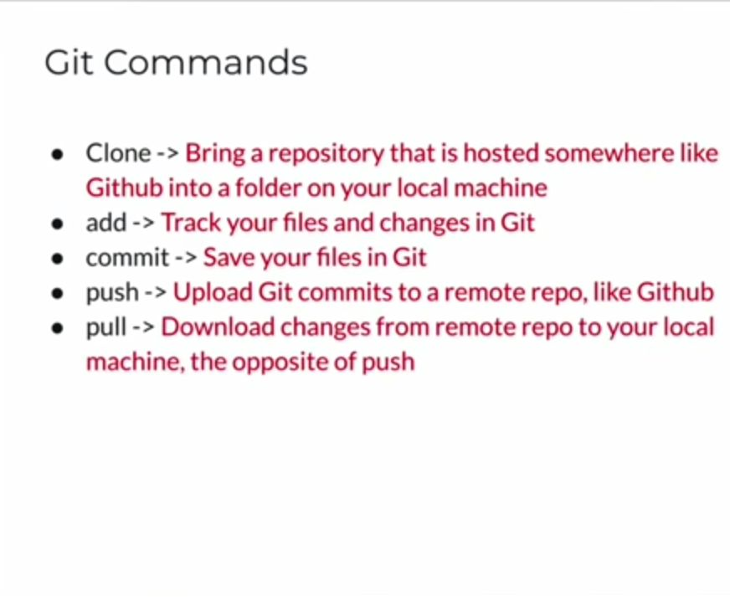

Slide 10
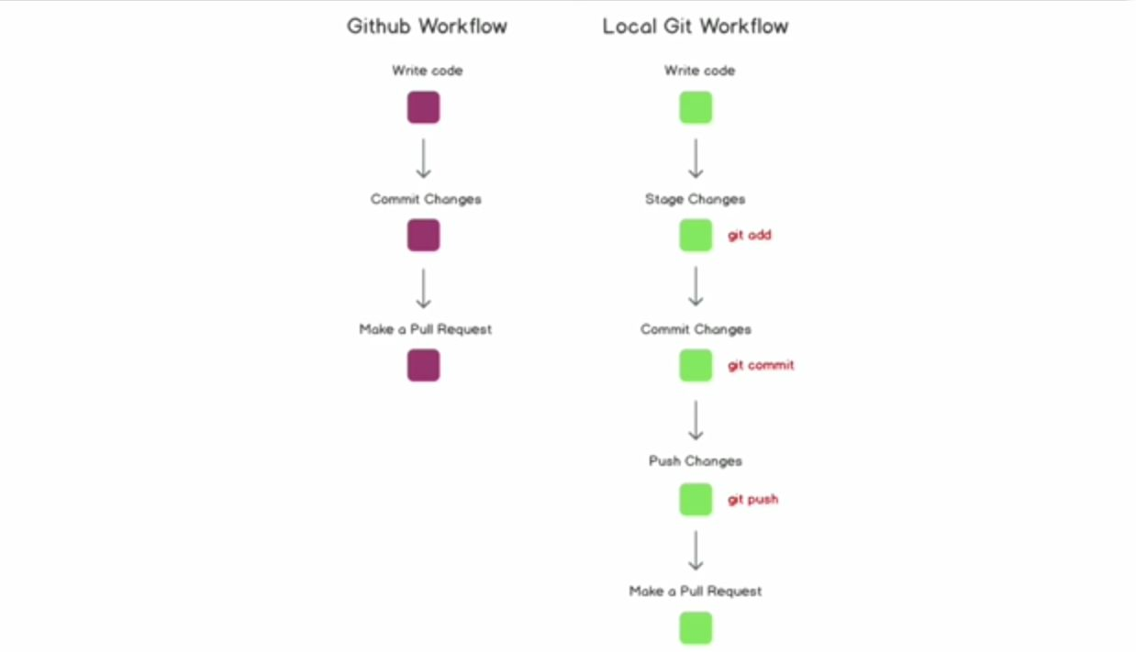

Slide 11
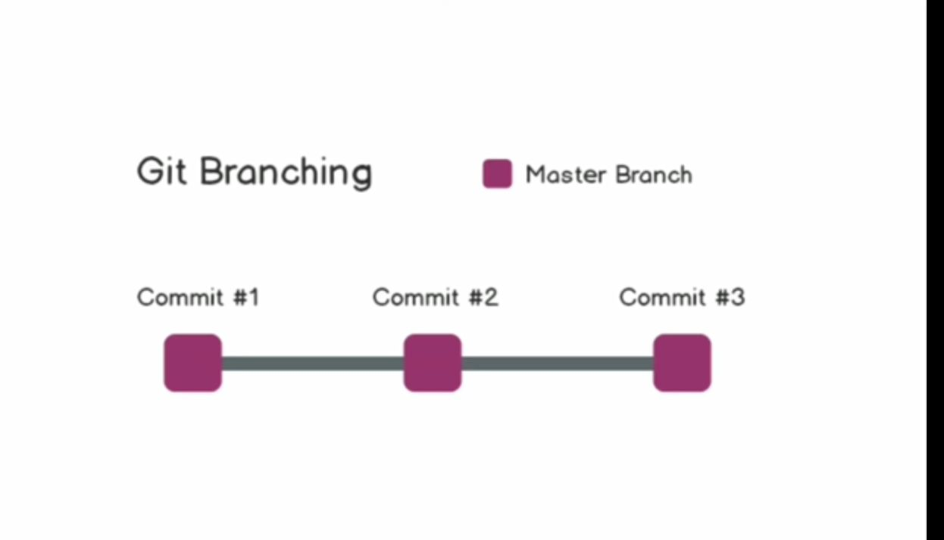
Git Branching
Create a branch to master. “$ git branch <new-branch>”
List all Branches “$ git branch”
Switch to branch and update the working directory “git checkout <branch> ”
Create and switch to it “$ git checkout –b <branch>”
Delete a merged Branch :“$ git branch –D <branch>”
Add tag for current commit:“$ git tag <tag-name>”

Slide 12
Stage edits to be committed to your git repository by using ??
"git add <filename>" to track the files that you want to add directly or “git add to add all files at the current directory level that you have worked on.
Commit changes using "git commit -m <message>" and be sure to leave a short but descriptive message detailing what the commit will change when merged to the master branch.
Push changes to save them by using “git push origin <branch name>"

Slide 13
Review your Repo
List new or modified files not yet committed.
$ git status
List commit History
$ git log –-oneline
Show changes to unstaged files.For changes to staged files
$ git diff
Show changes b/w teo commits.
$ git diff commit1_ID commit2_ID

Slide 14
Thank You

